Slide 1
Search Work
Mam Farah Naz
By : Sehar Elahi (20496)

Slide 2
Development of Cyber security (Abstract)
Introduction :
Hacking – Incidents linked to work files – because most companies work together.
A variety of encryption and decryption methods are here.
Problem :
Existing file encryption technologies are under threat.
As there are advance hacking technologies, we need development of stronger encryption algorithms.

Slide 3
Methods:
We use quantum computing to encrypt AES image files. Because shift is regular.
We change the regular shift into irregular using quantum random walk. Speed is simulated with IBM Qiskit quantum simulators for performance evaluation.
We get Encryption performance using NPCR and unified changing intensity.
Results:
we Get encrypted image file of same size, pixel and intensity

Slide 4
Key Words
Keywords that led to develop new algorithm.
AES
Qubit
Quantum Gate
Quantum simulator
Quantum random walk
I will discuss S-Box, means substitution bytes in AES.

Slide 5
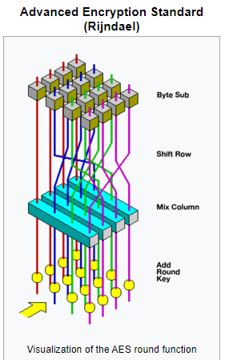
AES (Advance encryption method)
History
Original name: Rijndael.
Origins of Rijndael. The algorithm was created by the Belgian cryptologists, Vincent Rijmen and Joan Daemen (working out of Kathlieke Universiteit Leuven and Proton World International respectively), from whose surnames the word “Rijndael” is derived.

Slide 6
Plain text :
In computing, plain text is a loose term for data (e.g. file contents) that represent only characters of readable material but not its graphical representation nor other objects (floating-point numbers, images, etc.). ... In principle, plain text can be in any encoding, but occasionally the term is taken to imply ASCII.
Cipher text :
Cipher is an algorithm which is applied to plain text to get ciphertext. It is the unreadable output of an encryption algorithm. The term "cipher" is sometimes used as an alternative term for ciphertext. Ciphertext is not understandable until it has been converted into plain text using a key.

Slide 7
Old name:
Rijndael is a family of ciphers with different key and block sizes. For AES, NIST selected three members of the Rijndael family, each with a block size of 128 bits, but three different key(10, 12, 14 encryption rounds) lengths: 128, 192 and 256 bits. 128-bit most discussed.
Except for the last round in each case, all other rounds are identical.
Each round of processing includes one single-byte based substitution step, a row-wise permutation step, a column-wise mixing step, and the addition of the round key. The order in which these four steps are executed is different for encryption and decryption.
AES is a variant of the Rijndael block cipher developed by two Belgian cryptographers.
A block “Cipher is a method of encrypting data in blocks to produce ciphertext using a cryptographic key and algorithm”. Most modern block ciphers are designed to encrypt data in fixed-size blocks of either 64 or 128 bits.
Cryptography is the science of protecting information by transforming it into a secure format.
An example
Basic cryptography is a encrypted message in which letters are replaced with other characters. To decode the encrypted contents, you would need a grid or table that defines how the letters are transposed.

Slide 8
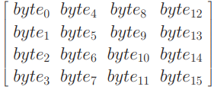
AES operates on a 4 × 4 column-major order array of bytes, termed the state.
To appreciate the processing steps used in a single round, it is best to think of a 128-bit block as consisting of a 4 × 4 array of bytes, arranged as follows:
Notice that the first four bytes of a 128-bit input block occupy the first column in the 4 × 4 array of bytes. The next four bytes occupy the second column, and so on.
 The 4 × 4 array of bytes shown above is referred to as the state array in AES. [If you are trying to create your own implementation of AES in Python, you will find following statement, which uses the notion of list comprehension in Python, very useful for creating an initialized structure that looks like the state array of AES:
state array = [[0 for x in range(4)] for x in range(4)]

Slide 9
Program
Next, try the following calls in relation to the structure thus created:
print statearray
print statearray[0]
print statearray[2][3] block = range(128)
for i in range(4):
for j in range(4): statearray[j][i] = block[32*i + 8*j:32*i + 8*(j+1)
] for i in range(4): for j in range(4):
print statearray[i][j], " ",
This is a nice warm-up exercise before you start implementing AES in Python.

Slide 10
For encryption, each round consists of the following four steps:
1) Substitute bytes
2) Shift rows
3) Mix columns
4) Add round key
. The last step consists of XORing the output of the previous three steps with four words from the key schedule.
The last round for encryption does not involve the “Mix columns” step.

Slide 11
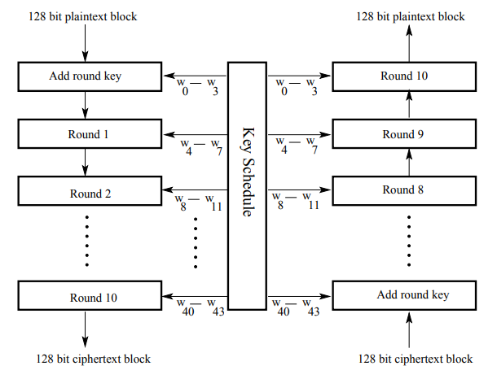

Slide 12
STEP 1:
STEP 1: (called Sub Bytes for byte-by-byte substitution during the forward process) (The corresponding substitution step used during decryption is called Inv SubBytes.) 
This step consists of using a 16 × 16 lookup table to find a replacement byte for a given byte in the input state array.
The entries in the lookup table are created by using the notions of multiplicative inverses in GF(28 ) and bit scrambling to destroy the bit-level correlations inside each byte.

Slide 13
STEP 4
STEP 4: (called AddRoundKey for adding the round key to the output of the previous step during the forward process) (The corresponding step during decryption is denoted Inv AddRoundKey for inverse add round key transformation.)

Slide 14
The goal of the substitution step is to reduce the correlation between the input bits and the output bits at the byte level. The bit scrambling part of the substitution step ensures that the substitution cannot be described in the form of evaluating a simple mathematical function.

Slide 15
I’ll now present the more traditional explanation of the byte substitution step. As mentioned earlier, it involves using a 16 × 16 table. To find the substitute byte for a given input byte, we divide the input byte into two 4-bit patterns, each yielding an integer value between 0 and 15. (We can represent these by their hex values 0 through F.) One of the hex values is used as a row index and the other as a column index for reaching into the 16 × 16 lookup table.

Slide 16
Traditional Explanation of Byte Substitution: Constructing the 16 × 16 Lookup Table
We first fill each cell of the 16 × 16 table with the byte obtained by joining together its row index and the column index. [The row index of this table runs from hex 0 through hex F. Likewise, the column index runs from hex 0 through hex F.]  For example, for the cell located at row index 2 and column indexed 7, we place hex 0x27 in the cell. So at this point the table will look like

Slide 17
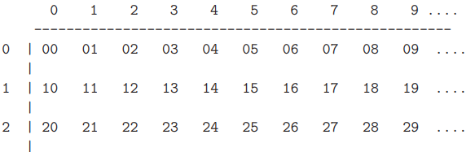
We next replace the value in each cell by its multiplicative inverse in GF(28 ) based on the irreducible polynomial

Slide 18
For Instance, 16-bytes are represented in 2D array.
The key size used for an AES cipher specifies the number of transformation rounds that convert the input, called the plaintext, into the final output, called the ciphertext. The number of rounds are as follows:
10 rounds for 128-bit keys.
12 rounds for 192-bit keys.
14 rounds for 256-bit keys.
Each round consists of several processing steps, including one that depends on the encryption key itself. A set of reverse rounds are applied to transform ciphertext back into the original plaintext using the same encryption key.

Slide 19
High-level description of the algorithm
1) Key Expansion – round keys are derived from the cipher key using the AES key schedule. AES requires a separate 128-bit round key block for each round plus one more.
Cipher key :
In cryptography, a cipher (or cypher) is an algorithm for performing encryption or decryption—a series of well-defined steps that can be followed as a procedure. ... The operation of a cipher usually depends on a piece of auxiliary information, called a key (or, in traditional NSA parlance, a crypto variable).
AES key schedule
AES uses a key schedule to expand a short key into a number of separate round keys. The three AES variants have a different number of rounds. Each variant requires a separate 128-bit round key for each round plus one more. The key schedule produces the needed round keys from the initial key.

Slide 20
2) Initial round key addition:
AddRoundKey – each byte of the state is combined with a byte of the round key using bitwise XOR.
3) 9, 11 or 13 rounds:
Sub Bytes – a non-linear substitution step where each byte is replaced with another according to a lookup table.
Shift Rows – a transposition step where the last three rows of the state are shifted cyclically a certain number of steps.
Mix Columns – a linear mixing operation which operates on the columns of the state, combining the four bytes in each column.
AddRoundKey
4) Final round (making 10, 12 or 14 rounds in total):
Sub Bytes
Shift Rows
AddRoundKey

Slide 21
The Sub Bytes step (Main article: Rijndael S-box)
In the sub bytes step, each byte a i,j in the state array is replaced with a sub byte s(a i,j) using an 8-bit substitution box. Note that before round 0, the state array is simple the plain text/input.
This operation provides the non-linearity in the cipher. The S-box used is derived from the multiplicative inverse over GF(28) known to have good non-linearity properties. To avoid attacks based on simple algebraic properties, the S-box is constructed by combining the inverse function with an invertible affine transformation. The S-box is also chosen to avoid any fixed points (and so is a derangement),
i.e., S(ai,j) != ai,j, also any opposite fixed points, i.e., S(ai,j) + ai,j != FF16.
While performing the decryption, the In Sub Bytes step (the inverse of Sub Bytes) is used, which requires first taking the inverse of the affine transformation and then finding the multiplicative inverse.

Slide 22
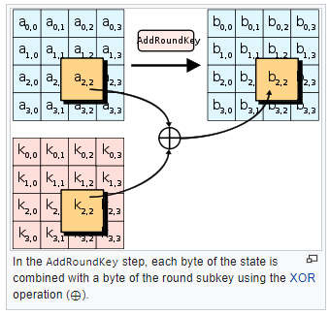
The AddRoundKey step
In the AddRoundKey step, the subkey is combined with the state. For each round, a subkey is derived from the main key using Rijndael's key schedule; each subkey is the same size as the state. The subkey is added by combining each byte of the state with the corresponding byte of the subkey using bitwise XOR.

Slide 23
Optimization of the cipher
On systems with 32-bit or larger words, it is possible to speed up execution of this cipher by combining the SubBytes and ShiftRows steps with the MixColumns step by transforming them into a sequence of table lookups. This requires four 256-entry 32-bit tables (together occupying 4096 bytes). A round can then be performed with 16 table lookup operations and 12 32-bit exclusive-or operations, followed by four 32-bit exclusive-or operations in the AddRoundKey step.^{[10]} Alternatively, the table lookup operation can be performed with a single 256-entry 32-bit table (occupying 1024 bytes) followed by circular rotation operations.
Using a byte-oriented approach, it is possible to combine the SubBytes, ShiftRows, and MixColumns steps into a single round operation

Slide 24
THANK YOU !

